Slide 1

Strings
Prepared and presented by - Naomi Padmore

Slide 2
Strings
Must include header file
- #include<string>
This means string characters can be accessed just like an array element
A string is an array of characters
Notes:
which can be modified.

Slide 3
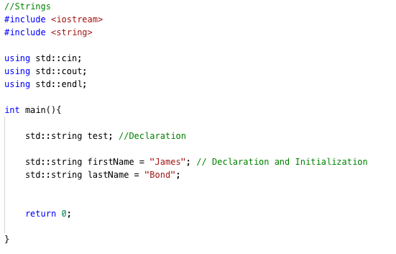
String Declaration and Initialization

Slide 4
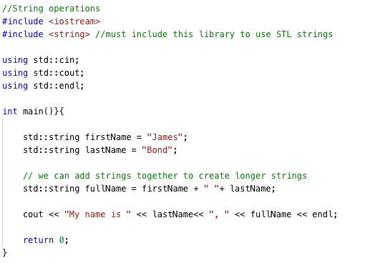
Operations on Strings
Adding strings

Slide 5
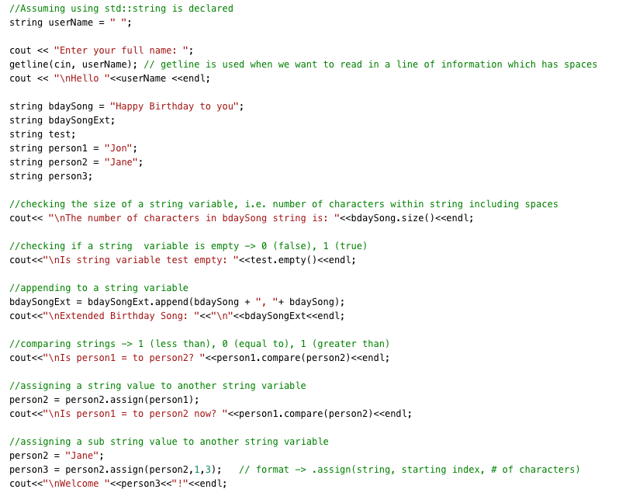
More Operations on Strings
.size()
.empty()
.append()
.compare()

Slide 6
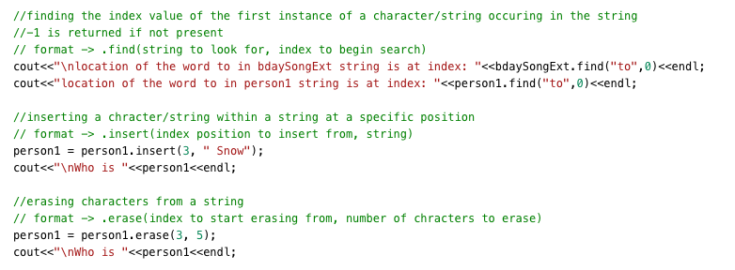
More Operations on Strings Cont’d
.assign()
.find()
.insert()
.erase()

Slide 7
For More String Functions ->
http://www.cplusplus.com/reference/cstring/

Slide 8
That’s All

